Slide 1
Teacher note (to be deleted before showing the PowerPoint): Prior to showing the PowerPoint, you may wish to find examples of each type of music from the Internet. You may also want to find a glockenspiel or xylophone so that you can try the activity on the ‘China’ slide of this PowerPoint.

Slide 3
Favourite Music
Talk about It
There are lots of different types of music. Types of music are called genres (you say it ‘jon-rahs’). How many genres of music do you know?
Different genres of music include classical, pop, RnB, rap and folk music.
Different music has its roots, or is more popular, in different places around the world. Let’s find out more about music around the world.

Slide 4
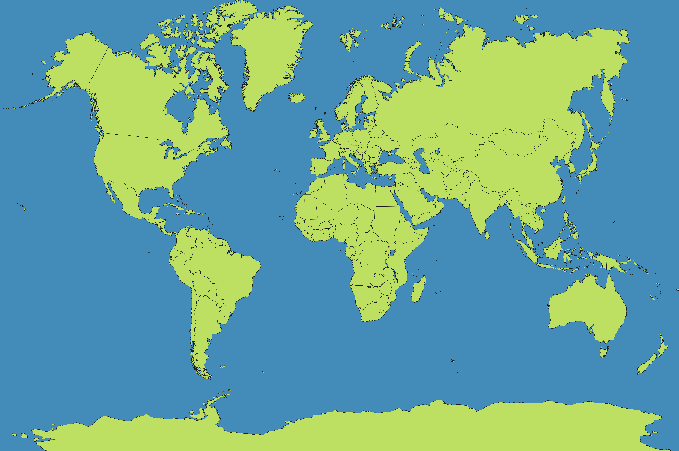
Around the World
Click on the map to find out more about the music from different places around the world.
Mexico
Spain
Israel
China
The Caribbean
India
West Africa
Indonesia
Brazil

Slide 5
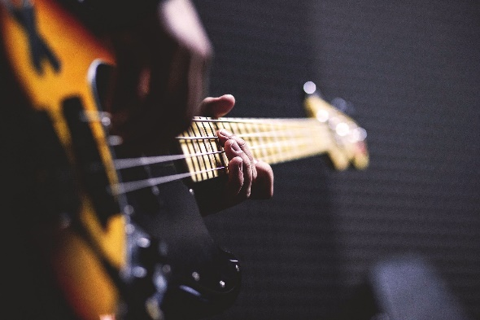
The Caribbean
The Caribbean is an area in-between North and South America. Caribbean countries include Jamaica, the Bahamas and Cuba.
There are many popular styles of music among the Caribbean islands, including salsa, calypso and compas. One of the most well-known styles is called reggae. Reggae music emphasises the second and fourth beat in each section of music (called a bar).
Key instruments in reggae are the bass guitar and drums. Famous reggae stars include Jimmy Cliff and Bob Marley.
Try It
Your teacher will count to four. Clap when your teacher says ‘two’ and ‘four’. Keep going until you’ve got the hang of it.
back

Slide 6
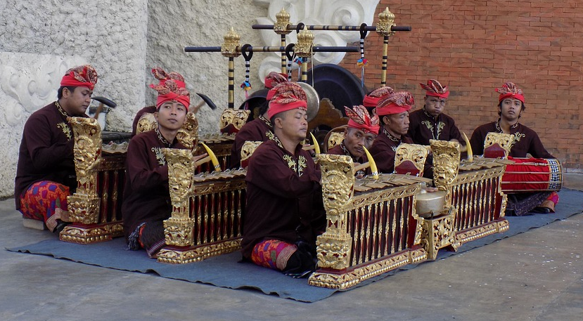
Indonesia
Indonesia is a country that is made up of islands in Asia. Gamelan is a popular form of traditional Indonesian music.
Gamelan music is played on metal percussion instruments, often hit with hammer-shaped mallets. A percussion instrument is one that you play by hitting it. Examples of the instruments in gamelan music include xylophones, drums and gongs. Sometimes, bamboo flutes, stringed instruments and voices are added to the music.
back

Slide 7
Brazil
Brazil is on the continent of South America. Bossa nova is a popular style of Brazilian music. It means ‘new trend’ in Portuguese, which is the language spoken in Brazil.
The main instrument in bossa nova is the guitar. There are also percussion instruments, such as drums and claves.
One of the most famous bossa nova songs is ‘The Girl from Ipanema’.
Claves
back
“Claves hg” by Hgrobe is licensed under CC BY 2.0

Slide 8
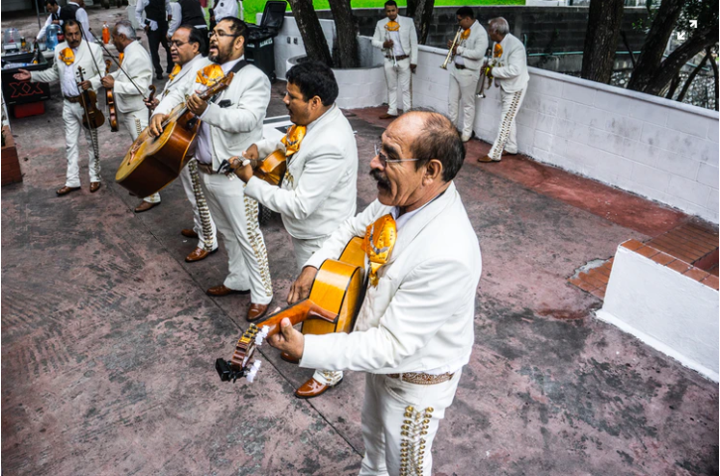
Mexico
Mexico is in North America. One example of traditional Mexican music is mariachi. A mariachi band is often made up of different types of guitars, trumpets and violins. All the musicians sing and wear special outfits called charro suits.
Mariachi musicians often walk as they perform. A famous mariachi song is ‘La Cucaracha’, which is Spanish for ‘the cockroach’. Spanish is the language spoken in Mexico.
back

Slide 9
Israel
Lots of people who live in Israel follow the Jewish religion so Jewish music is popular there.
Jewish music is often in a minor key. Music written in a minor key can sometimes sound sad, spooky or very serious, although Jewish music is actually very joyful. The music will often start quite slowly and quietly before getting faster and louder.
A piano accordion, double bass and clarinet are often played in Jewish music. ‘Hava Nagila’ is a well-known example of this type of music. It means ‘let’s rejoice’ in the Hebrew language.
back

Slide 10
China
Traditional Chinese music is played using a pentatonic scale. This means the fourth and seventh note from other musical scales are missing.
Erhu
Try It
On a glockenspiel or xylophone, play the notes C, D, E, F, G, A, B, C. Now only play C, D, E, G, B, C. These are the notes in a pentatonic scale.
Chinese instruments include stringed instruments, such as the erhu, a wooden flute called the dizi and percussion, such as drums and cymbals.
back
“Erhu” by LDHan is licensed under CC BY 2.0

Slide 11
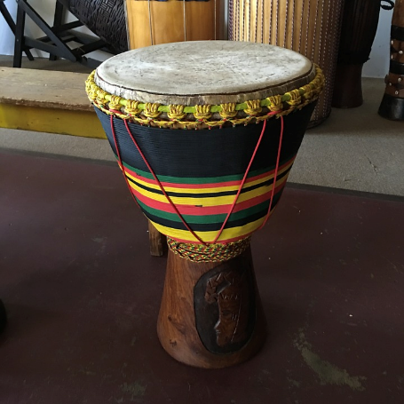
West Africa
West Africa is a large area made up of many countries, including Benin, Cameroon, Ghana, Nigeria, Sierra Leone and Togo. Each country has its own musical tradition but the music in the area has some things in common.
West African music can often have two or more rhythms playing at one time.
Try It
Your teacher will split you into two groups. One group will tap two beats on the table. The other group will tap three beats in the same time it takes the first group to tap their two beats.
West African music often uses a special drum called a djembe and an instrument called the talking drum. The drummer can change the pitch of the drum to make it sound like a human talking.
back
Djembe

Slide 12
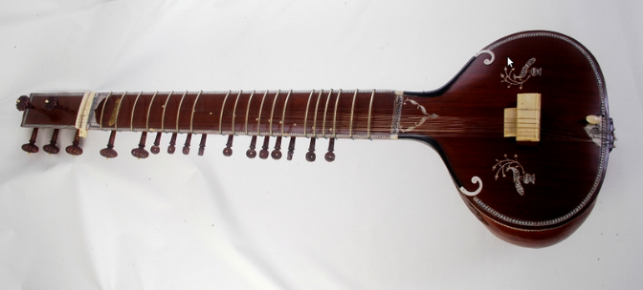
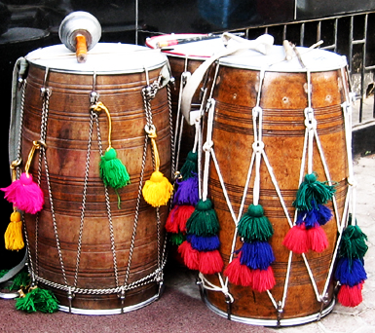
India
This is a sitar. It is an instrument traditionally used in Indian music as well as in some other nearby countries.
This is a dhol. It is worn on a strap across the body. The strings can be tightened to make the drum sound higher or lower. A dhol is played with two sticks, one at either side.
“Sitar” by Patricio.lorente is licensed under CC BY 2.0
Bhangra is a popular style of music in India. It is very lively and good to dance to. Bhangra has become popular across the world.
“Drums” by Nikita Mehta from UAE is licensed under CC BY 2.0
back

Slide 13
Spain
Spain has a lot of traditional music styles, one of which is flamenco. Flamenco is a mixture of guitar playing, singing, hand clapping and finger clicking. Sometimes the guitarist will hit the guitar to make it sound like a drum.
Flamenco music is lively and often quite fast. It is good music to dance to and there is a style of dance which is also called flamenco.
back

